Slide 1

Laravel Training
Pusat Geospatial Negara (PGN)
17 - 20 June 2025
Favourite Trainer Sdn Bhd
Trainer: Azman b. Zakaria

Slide 2
What is Laravel ?
Wifi
teknodsb
xs2T3kn0d
Laravel is a free, open-source PHP web application framework designed for building modern, robust, and scalable web applications.

Slide 3
Why Laravel ?
Elegant Syntax & Developer Experience
Rich Feature Set Out-of-the-Box
Eloquent ORM
Blade Templating Engine
Artisan CLI
Great Community & Ecosystem

Slide 4
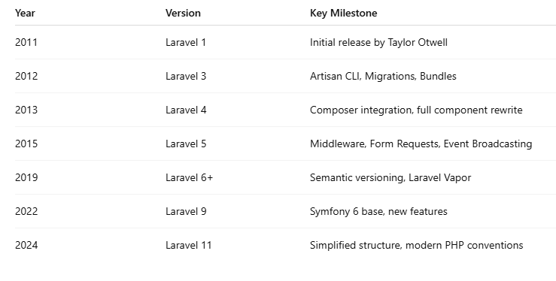
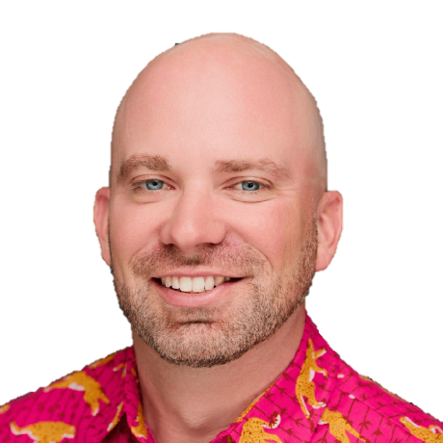
History of Laravel
Created by: Taylor Otwell in 2011
2025 Laravel 12

Slide 5
Tools
Laragon
Visual Studio Code
Terminal (cmder)
Git
Composer

Slide 6
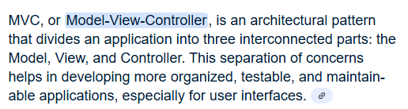
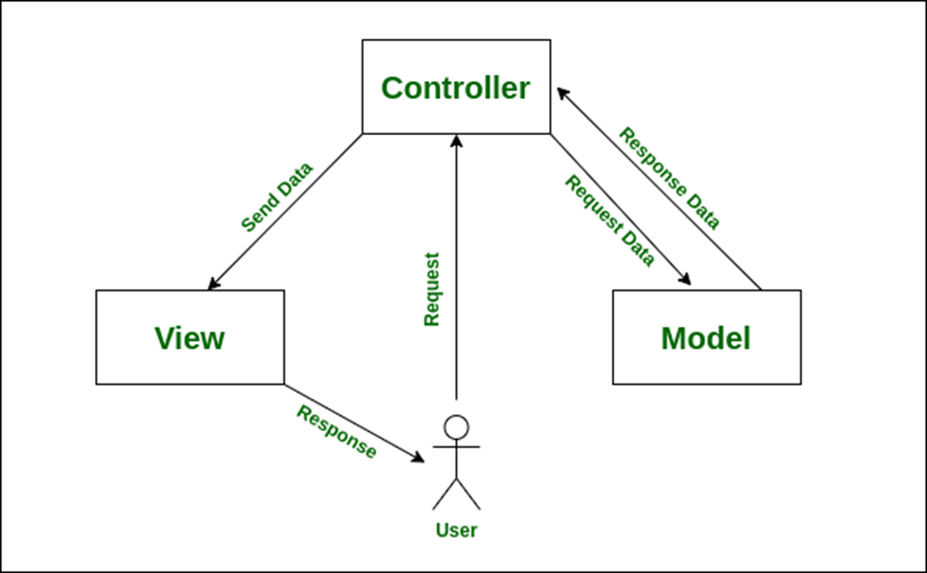
MVC
MVC + R
Convention over configuration
DB
Welcome.blade.php
Route, web.php

Slide 7
Summary
Composer create-project Laravel/Laravel lara-pgn
  Create project dlm c:\laragon\www\lara-pgn
Create database lara_pgn
Edit file .env, setup db connection
Php artisan migrate
http://localhost/lara-pgn/public ATAU http://lara-pgn.test

Slide 8
Revision day #1
Installation – laragon v6 (php 8.1, apache, mysql 8, composer, Heidi sql)
>composer create-project Laravel/Laravel lara-pgn
>php –version
http://lara-pgn.test OR http://localhost/lara-pgn/public
Model View Controller + Route
Route: routes/web.php, view - .blade.php
Artisan – command line tool.
  >php artisan make:controller <nama>
  >php artisan migrate
  >php artisan make:model <nama>
  >php artisan list

Slide 9
Revision day #1 – con.
Controller, YourController, PostController
Model, table posts (plural), nama model Post (singular)
“Convention over configuration”
$post = new Post(), …. $post->save();
Route: test/{id} – wajib test/{id?} – sunat
Route::group([‘prefix’ => ‘dashboard’], function() {….});
CRUD – create, retrieve, update, delete
Auth, autho, blade, form, validation…

Slide 10
Revision day #2
Create project, guna composer
CategoryController, Category, table: category, posts,
Views (blade template). @foreach(), {{ }}, @csrf
Tinker. Post::find(1), Post::where(‘id’, 1)->first(), get(), orderBy(), sum(), count(), min(), max(), select(), … paginate(), create(), save() insert/update, delete(), update()
Post::all()

Slide 11
Revision day #3
Complete CRUD, delete, update
Layout dan Bootstrap integration
@yield, @extends(), @section @endsection
Authentication / login
Middleware – guna melalui route
Auth::attempt(), Auth::check(), Auth::logout()
Hash::make(‘1234’) – jana password

Slide 12
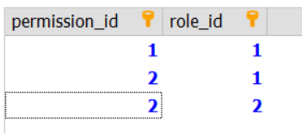
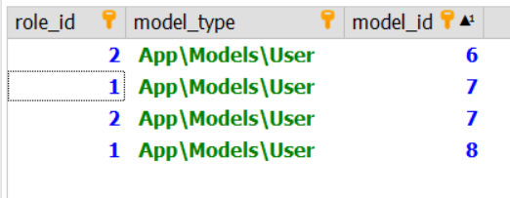
role_has_permissons
Roles
- id
edit
create
create
Writer
Writer
admin
Roles_has_permissions
permissions
Model_has_roles
model_id
Role_id
Users
- id
Model_has_roles
admin
writer
admin
writer
Azman
John
John
ahmad
Model_has_permissions
permission_id
Model_id
Model_type

Slide 13
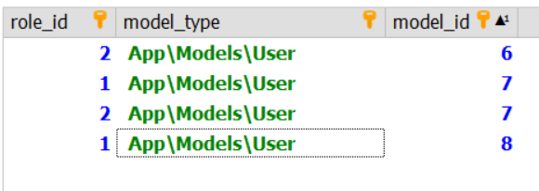
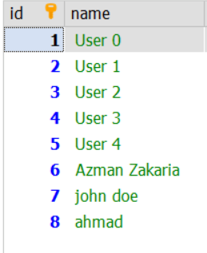
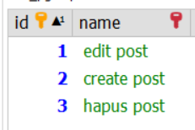
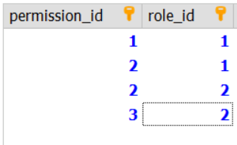
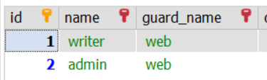
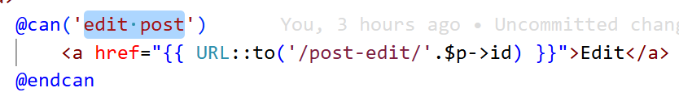
Model_has_roles
users
permissions
Role_has_permissions
roles

Slide 14
Plan day 4
Authorization
Sample project – CRUD
  Validation
  Template bootstrap

